Slide 1
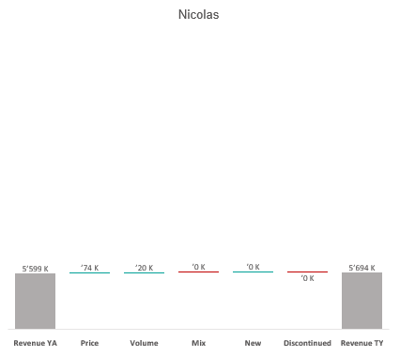
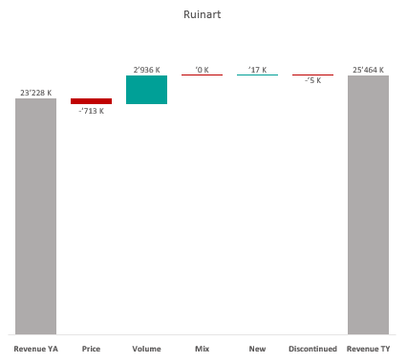
Revenue by Price vs. Volume vs. Mix analysis (Replace with So What)
Revenue by Price vs. Volume vs. Mix analysis | Nicolas vs. Ruinart | Effervescents | NATIONAL | P12M
DATA SOURCE: Trade Panel/Retailer Data | Ending June 2025

Slide 2
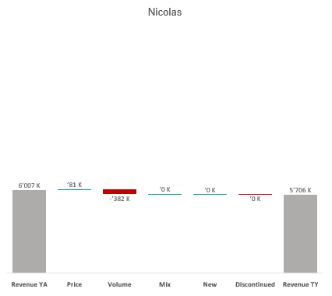
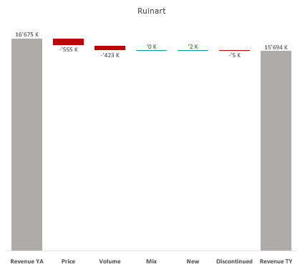
Revenue by Price vs. Volume vs. Mix analysis (Replace with So What)
Revenue by Price vs. Volume vs. Mix analysis | Nicolas vs. Ruinart | Effervescents | NICOLAS | P12M
DATA SOURCE: Trade Panel/Retailer Data | Ending June 2025

Slide 3
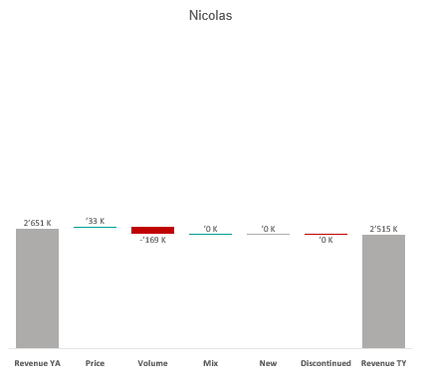
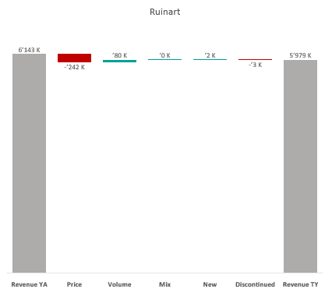
Revenue by Price vs. Volume vs. Mix analysis (Replace with So What)
Revenue by Price vs. Volume vs. Mix analysis | Nicolas vs. Ruinart | Effervescents | NICOLAS QCN | P12M
DATA SOURCE: Trade Panel/Retailer Data | Ending June 2025

Slide 4
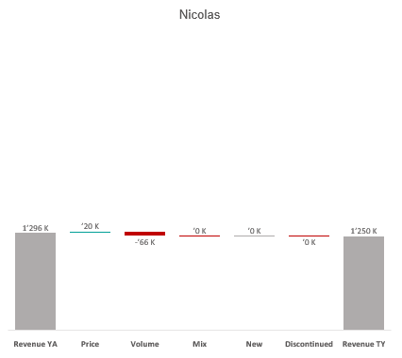
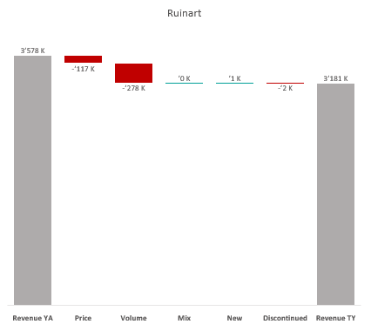
Revenue by Price vs. Volume vs. Mix analysis (Replace with So What)
Revenue by Price vs. Volume vs. Mix analysis | Nicolas vs. Ruinart | Effervescents | NICOLAS VCN | P12M
DATA SOURCE: Trade Panel/Retailer Data | Ending June 2025

Slide 5
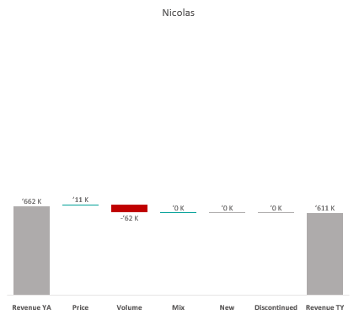
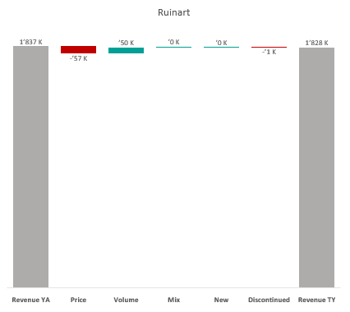
Revenue by Price vs. Volume vs. Mix analysis (Replace with So What)
Revenue by Price vs. Volume vs. Mix analysis | Nicolas vs. Ruinart | Effervescents | NICOLAS QCT | P12M
DATA SOURCE: Trade Panel/Retailer Data | Ending June 2025

Slide 6
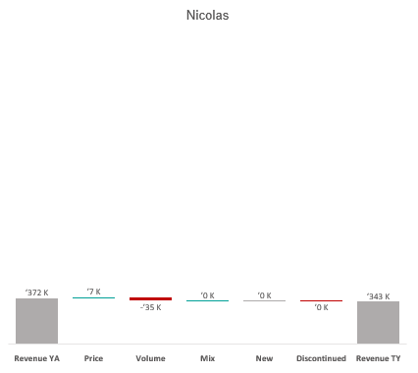
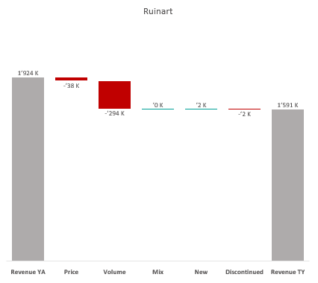
Revenue by Price vs. Volume vs. Mix analysis (Replace with So What)
Revenue by Price vs. Volume vs. Mix analysis | Nicolas vs. Ruinart | Effervescents | NICOLAS QCA | P12M
DATA SOURCE: Trade Panel/Retailer Data | Ending June 2025

Slide 7
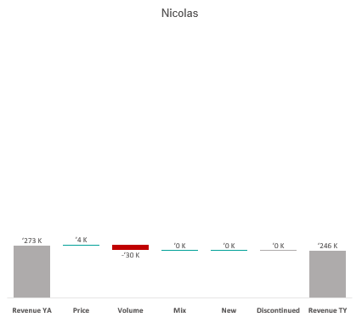
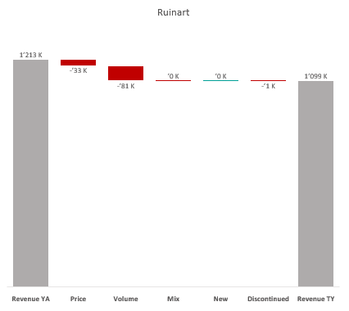
Revenue by Price vs. Volume vs. Mix analysis (Replace with So What)
Revenue by Price vs. Volume vs. Mix analysis | Nicolas vs. Ruinart | Effervescents | NICOLAS CCP | P12M
DATA SOURCE: Trade Panel/Retailer Data | Ending June 2025

Slide 8
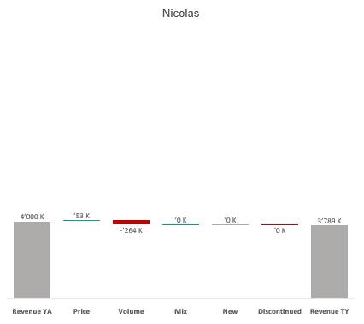
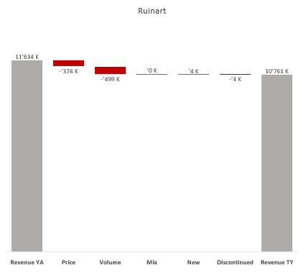
Revenue by Price vs. Volume vs. Mix analysis (Replace with So What)
Revenue by Price vs. Volume vs. Mix analysis | Nicolas vs. Ruinart | Effervescents | NICOLAS IDF | P12M
DATA SOURCE: Trade Panel/Retailer Data | Ending June 2025

Slide 9
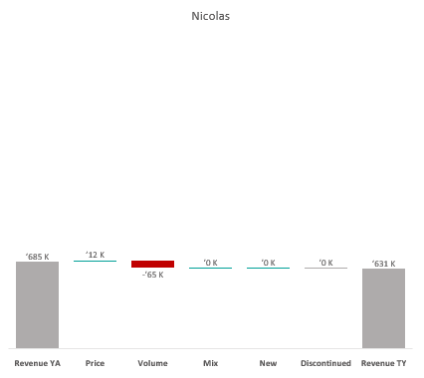
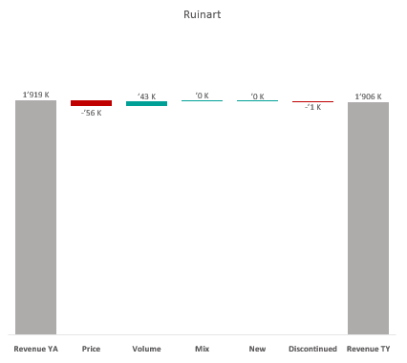
Revenue by Price vs. Volume vs. Mix analysis (Replace with So What)
Revenue by Price vs. Volume vs. Mix analysis | Nicolas vs. Ruinart | Effervescents | NICOLAS PAC | P12M
DATA SOURCE: Trade Panel/Retailer Data | Ending June 2025

Slide 10
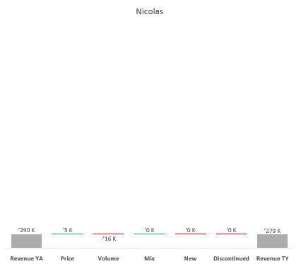
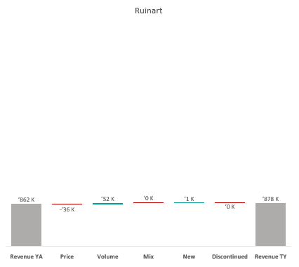
Revenue by Price vs. Volume vs. Mix analysis (Replace with So What)
Revenue by Price vs. Volume vs. Mix analysis | Nicolas vs. Ruinart | Effervescents | NICOLAS RHO | P12M
DATA SOURCE: Trade Panel/Retailer Data | Ending June 2025

Slide 11
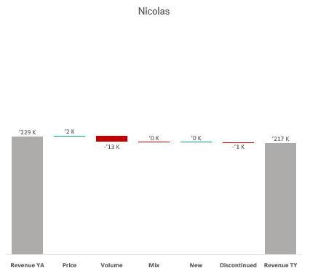
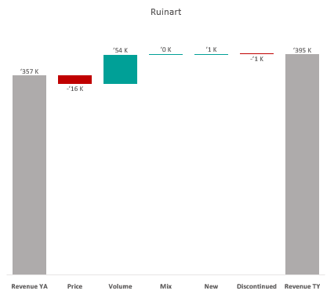
Revenue by Price vs. Volume vs. Mix analysis (Replace with So What)
Revenue by Price vs. Volume vs. Mix analysis | Nicolas vs. Ruinart | Effervescents | NICOLAS AQU | P12M
DATA SOURCE: Trade Panel/Retailer Data | Ending June 2025

Slide 12
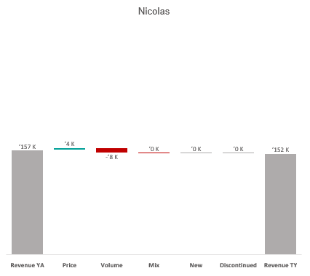
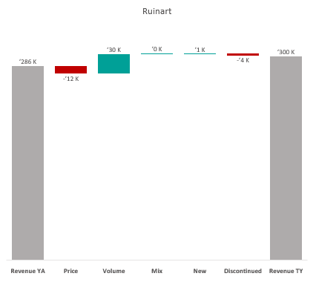
Revenue by Price vs. Volume vs. Mix analysis (Replace with So What)
Revenue by Price vs. Volume vs. Mix analysis | Nicolas vs. Ruinart | Effervescents | NICOLAS EST | P12M
DATA SOURCE: Trade Panel/Retailer Data | Ending June 2025

Slide 13
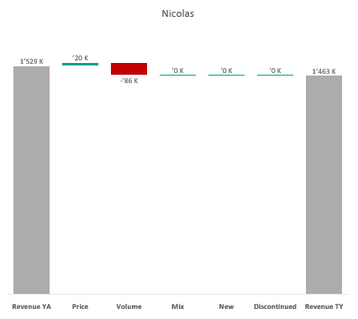
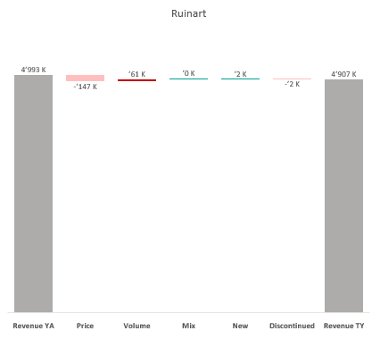
Revenue by Price vs. Volume vs. Mix analysis (Replace with So What)
Revenue by Price vs. Volume vs. Mix analysis | Nicolas vs. Ruinart | Effervescents | CA A | P12M
DATA SOURCE: Trade Panel/Retailer Data | Ending Apr 2024

Slide 14
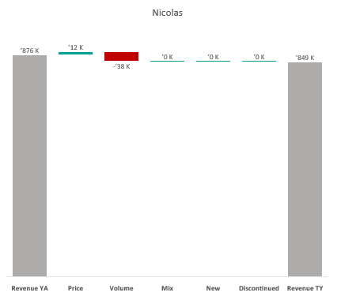
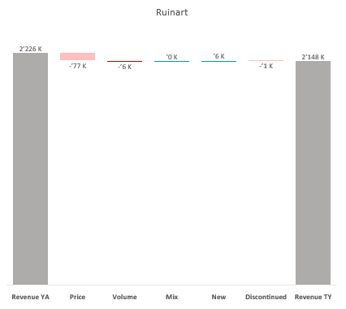
Revenue by Price vs. Volume vs. Mix analysis (Replace with So What)
Revenue by Price vs. Volume vs. Mix analysis | Nicolas vs. Ruinart | Effervescents | CA B | P12M
DATA SOURCE: Trade Panel/Retailer Data | Ending Apr 2024

Slide 15
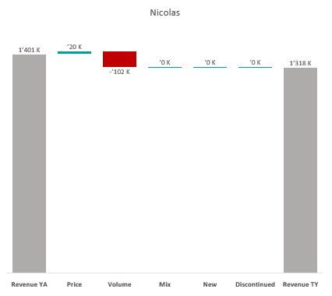
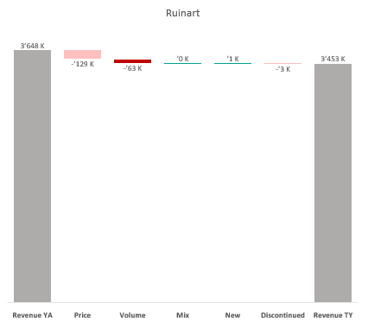
Revenue by Price vs. Volume vs. Mix analysis (Replace with So What)
Revenue by Price vs. Volume vs. Mix analysis | Nicolas vs. Ruinart | Effervescents | CA C | P12M
DATA SOURCE: Trade Panel/Retailer Data | Ending Apr 2024

Slide 16
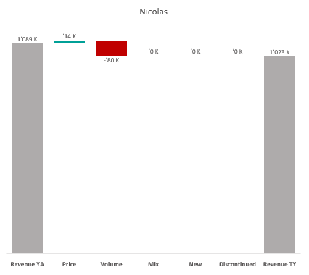
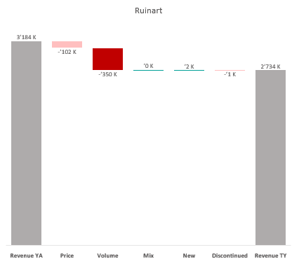
Revenue by Price vs. Volume vs. Mix analysis (Replace with So What)
Revenue by Price vs. Volume vs. Mix analysis | Nicolas vs. Ruinart | Effervescents | CA D | P12M
DATA SOURCE: Trade Panel/Retailer Data | Ending Apr 2024

Slide 17
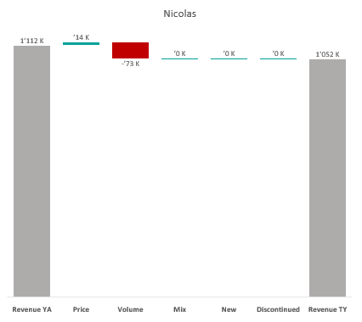
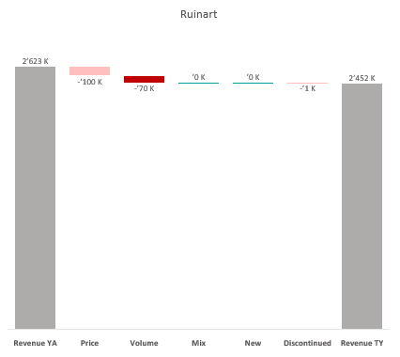
Revenue by Price vs. Volume vs. Mix analysis (Replace with So What)
Revenue by Price vs. Volume vs. Mix analysis | Nicolas vs. Ruinart | Effervescents | CA E | P12M
DATA SOURCE: Trade Panel/Retailer Data | Ending Apr 2024

Slide 18
Revenue by Price vs. Volume vs. Mix analysis (Replace with So What)
Revenue by Price vs. Volume vs. Mix analysis | Nicolas vs. Ruinart | Champagnes | NATIONAL | P12M
DATA SOURCE: Trade Panel/Retailer Data | Ending June 2025

Slide 19
Revenue by Price vs. Volume vs. Mix analysis (Replace with So What)
Revenue by Price vs. Volume vs. Mix analysis | Nicolas vs. Ruinart | Champagnes | NICOLAS | P12M
DATA SOURCE: Trade Panel/Retailer Data | Ending June 2025

Slide 20
Revenue by Price vs. Volume vs. Mix analysis (Replace with So What)
Revenue by Price vs. Volume vs. Mix analysis | Nicolas vs. Ruinart | Champagnes | NICOLAS QCN | P12M
DATA SOURCE: Trade Panel/Retailer Data | Ending June 2025

Slide 21
Revenue by Price vs. Volume vs. Mix analysis (Replace with So What)
Revenue by Price vs. Volume vs. Mix analysis | Nicolas vs. Ruinart | Champagnes | NICOLAS VCN | P12M
DATA SOURCE: Trade Panel/Retailer Data | Ending June 2025

Slide 22

Revenue by Price vs. Volume vs. Mix analysis (Replace with So What)
Revenue by Price vs. Volume vs. Mix analysis | Nicolas vs. Ruinart | Champagnes | NICOLAS QCT | P12M
DATA SOURCE: Trade Panel/Retailer Data | Ending June 2025

Slide 23
Revenue by Price vs. Volume vs. Mix analysis (Replace with So What)
Revenue by Price vs. Volume vs. Mix analysis | Nicolas vs. Ruinart | Champagnes | NICOLAS QCA | P12M
DATA SOURCE: Trade Panel/Retailer Data | Ending June 2025

Slide 24

Revenue by Price vs. Volume vs. Mix analysis (Replace with So What)
Revenue by Price vs. Volume vs. Mix analysis | Nicolas vs. Ruinart | Champagnes | NICOLAS CCP | P12M
DATA SOURCE: Trade Panel/Retailer Data | Ending June 2025

Slide 25
Revenue by Price vs. Volume vs. Mix analysis (Replace with So What)
Revenue by Price vs. Volume vs. Mix analysis | Nicolas vs. Ruinart | Champagnes | NICOLAS IDF | P12M
DATA SOURCE: Trade Panel/Retailer Data | Ending June 2025

Slide 26

Revenue by Price vs. Volume vs. Mix analysis (Replace with So What)
Revenue by Price vs. Volume vs. Mix analysis | Nicolas vs. Ruinart | Champagnes | NICOLAS PAC | P12M
DATA SOURCE: Trade Panel/Retailer Data | Ending June 2025

Slide 27
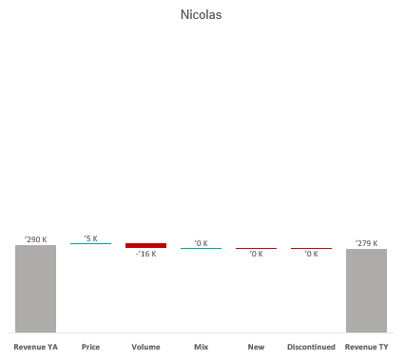
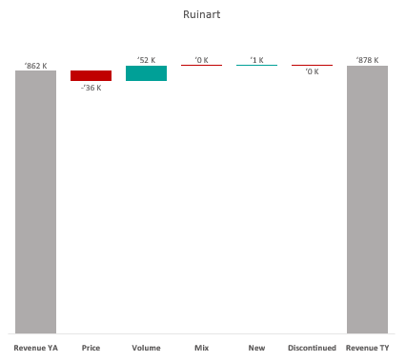
Revenue by Price vs. Volume vs. Mix analysis (Replace with So What)
Revenue by Price vs. Volume vs. Mix analysis | Nicolas vs. Ruinart | Champagnes | NICOLAS RHO | P12M
DATA SOURCE: Trade Panel/Retailer Data | Ending June 2025

Slide 28
Revenue by Price vs. Volume vs. Mix analysis (Replace with So What)
Revenue by Price vs. Volume vs. Mix analysis | Nicolas vs. Ruinart | Champagnes | NICOLAS AQU | P12M
DATA SOURCE: Trade Panel/Retailer Data | Ending June 2025

Slide 29

Revenue by Price vs. Volume vs. Mix analysis (Replace with So What)
Revenue by Price vs. Volume vs. Mix analysis | Nicolas vs. Ruinart | Champagnes | NICOLAS EST | P12M
DATA SOURCE: Trade Panel/Retailer Data | Ending June 2025

Slide 30
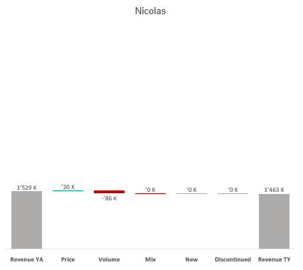
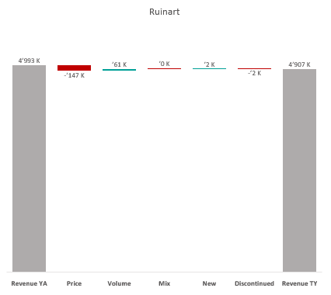
Revenue by Price vs. Volume vs. Mix analysis (Replace with So What)
Revenue by Price vs. Volume vs. Mix analysis | Nicolas vs. Ruinart | Champagnes | CA A | P12M
DATA SOURCE: Trade Panel/Retailer Data | Ending June 2025

Slide 31
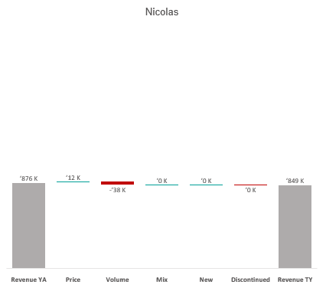
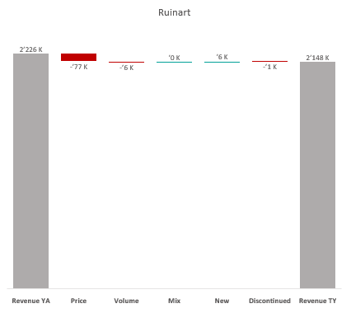
Revenue by Price vs. Volume vs. Mix analysis (Replace with So What)
Revenue by Price vs. Volume vs. Mix analysis | Nicolas vs. Ruinart | Champagnes | CA B | P12M
DATA SOURCE: Trade Panel/Retailer Data | Ending June 2025

Slide 32
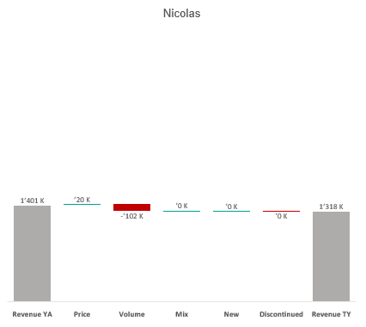
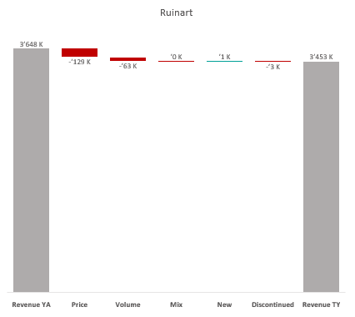
Revenue by Price vs. Volume vs. Mix analysis (Replace with So What)
Revenue by Price vs. Volume vs. Mix analysis | Nicolas vs. Ruinart | Champagnes | CA C | P12M
DATA SOURCE: Trade Panel/Retailer Data | Ending June 2025

Slide 33
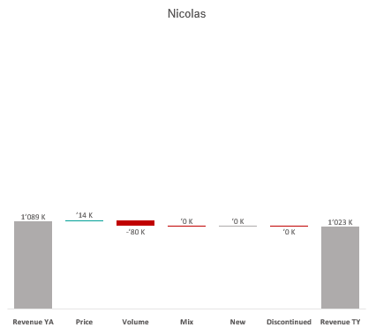
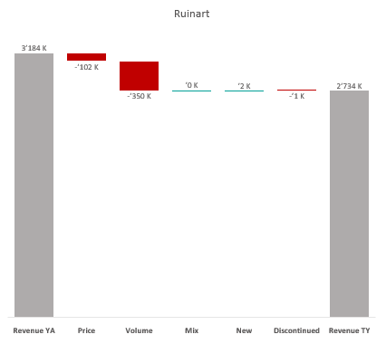
Revenue by Price vs. Volume vs. Mix analysis (Replace with So What)
Revenue by Price vs. Volume vs. Mix analysis | Nicolas vs. Ruinart | Champagnes | CA D | P12M
DATA SOURCE: Trade Panel/Retailer Data | Ending June 2025

Slide 34
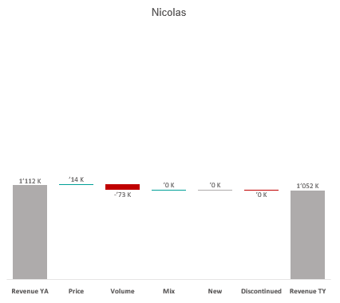
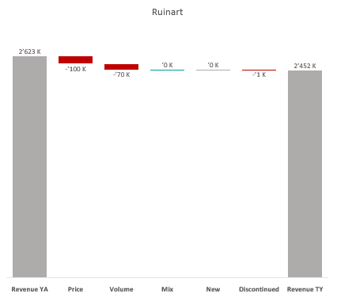
Revenue by Price vs. Volume vs. Mix analysis (Replace with So What)
Revenue by Price vs. Volume vs. Mix analysis | Nicolas vs. Ruinart | Champagnes | CA E | P12M
DATA SOURCE: Trade Panel/Retailer Data | Ending June 2025

